Slide 1
DANGEROUS FARM INSECTS CLASSIFICATION
COMP 263-003 Deep Learning - Centennial College
Professor Mohammad Saiful Islam
Presented by:
Ying Shen
Piyush Goel
Harikrishna Jetti
Azin Katiraee

Slide 2
Outline
Description and scope of the problem
The dataset
Methodology
Results
Technical challenges & Solutions

Slide 3
Description and Scope of the problem
The project is to develop and implement a deep learning-based framework for the classification of dangerous farm insects, leveraging a dataset of high-quality images representing 15 distinct insect species.
The primary reason for undertaking this project is to enhance agricultural management by providing an effective tool for identifying harmful pests.
This is crucial for preventing crop damage and facilitating more effective pest control measures, thereby improving the overall efficiency and sustainability of agricultural practices.

Slide 4
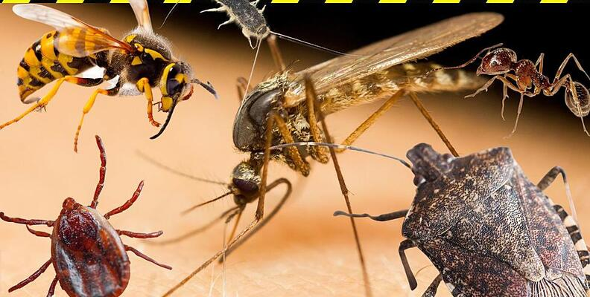
The dataset
15 different categories. Overall, 1591 images.
Each category typically contains about 100 images, with total images per class ranging from 88 (Aphids) to 119 (Spider Mites).
The images are in RGB format with 3 color channels.
The average image size is 758x1015 pixels.
There are a few images with non-standard color channel counts (1 or 4).
The average aspect ratio is 1.34, suggesting a landscape orientation for the images.

Slide 5
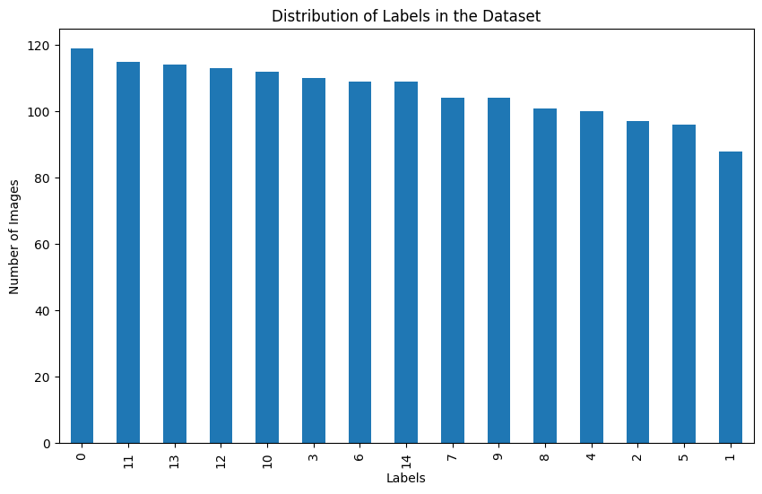

Slide 6
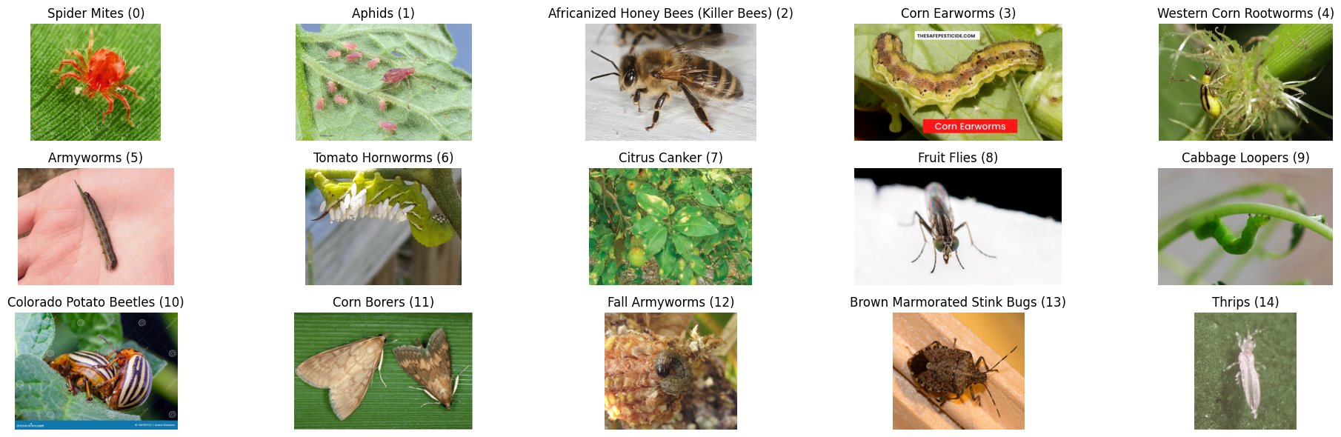

Slide 7
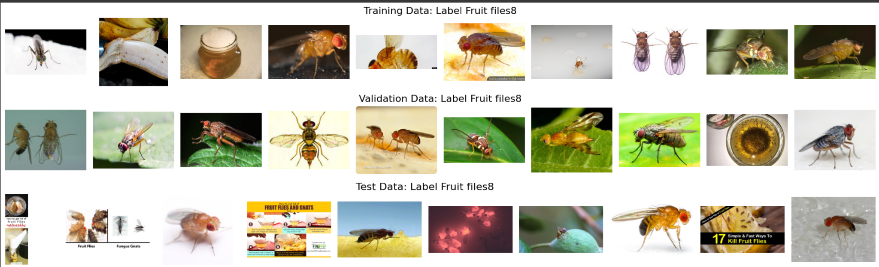

Slide 8
Methodology
Supervised Learning
Unsupervised Learning
State of the art model

Slide 9
Supervised Learning (CNN)
Architecture:
A Sequential model is used, which is a linear stack of layers.
It consists of three blocks, each with a convolutional layer (Conv2D) followed by a max pooling layer (MaxPooling2D). Convolutional layers use 32, 64, and 128 filters respectively, which extract features from the images.
Flatten layer converts the 2D feature maps into a 1D feature vector, making it possible to add fully connected layers.
Dense layer with 256 units and rectified linear unit (ReLU) activation function adds the ability to learn non-linear combinations of features.
Dropout layer with a rate of 0.5 helps prevent overfitting by randomly setting a fraction of input units to 0 at each update during training.
Final Dense layer with a number of units equal to the number of classes and softmax activation function, which outputs probabilities of each class.
Regularization:
The Dense layer includes L2 regularization, which penalizes large weights, helping to keep the model simpler and reducing overfitting.
Compilation:
The model is compiled with the Adam optimizer, a popular choice for deep learning which adapts the learning rate during training.
The loss function used is sparse_categorical_crossentropy, which is appropriate for multi-class classification tasks where each class is represented as a unique integer.
The metric 'accuracy' is used to monitor the training process.

Slide 10
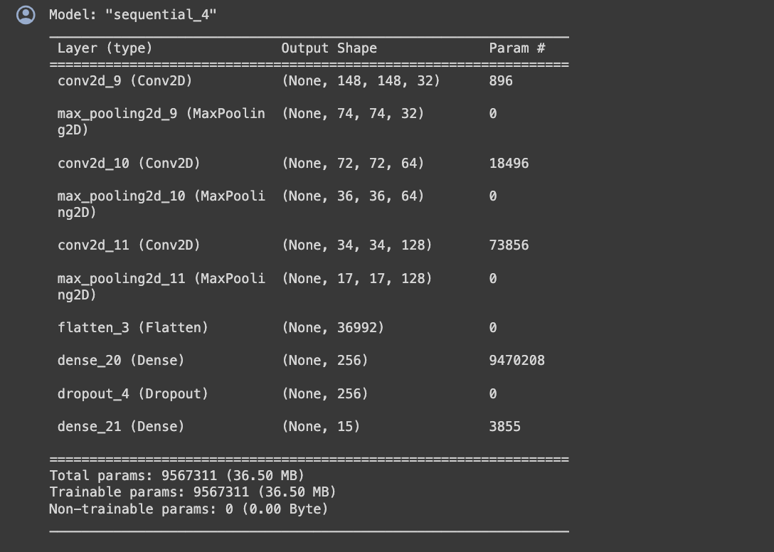

Slide 11
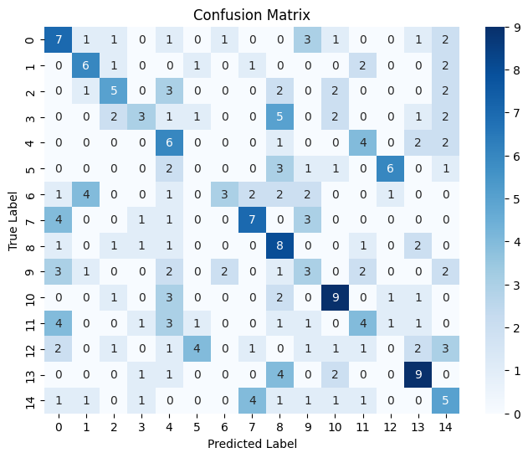
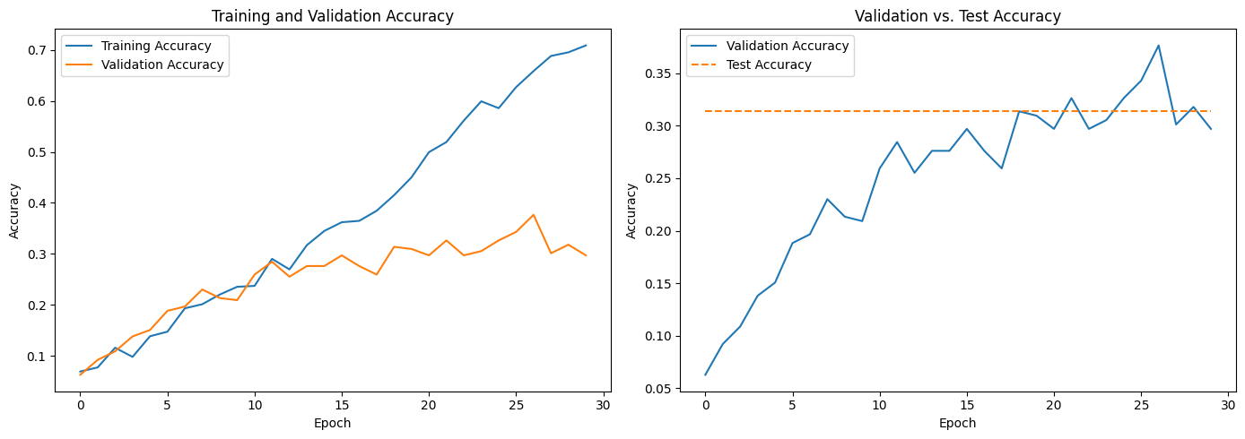
Train Accuracy: 0.7088949084281921
Validation Accuracy: 0.2970711290836334
Test Accuracy: 0.3138075313807531

Slide 12
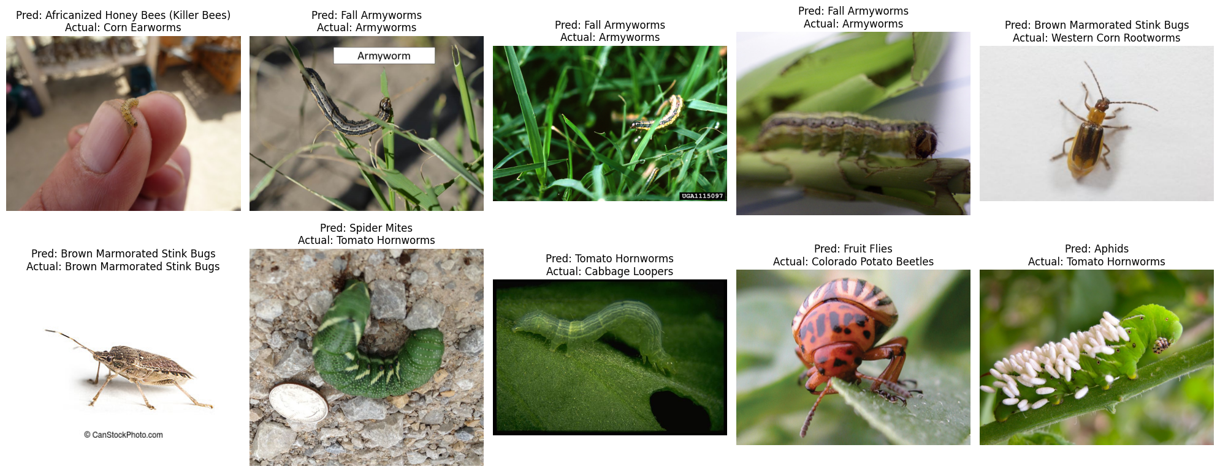

Slide 13
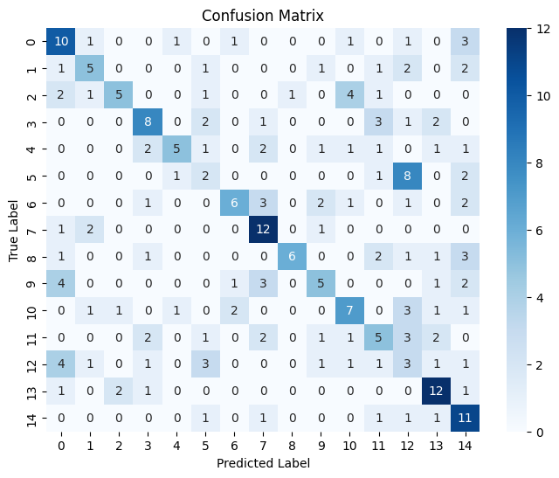
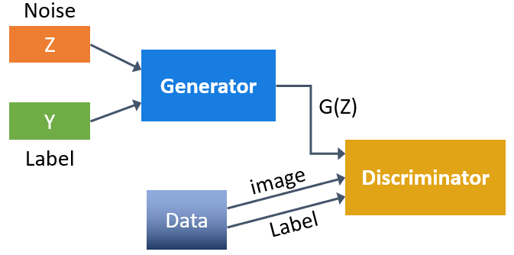
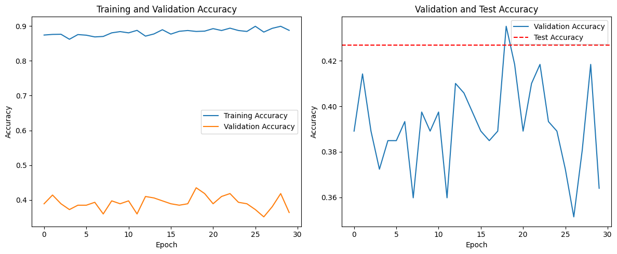
Unsupervised Learning(GAN)
Train Accuracy: 0.8876909017562866
Validation Accuracy: 0.36401674151420593
Test Accuracy: 0.42677824267782427

Slide 14
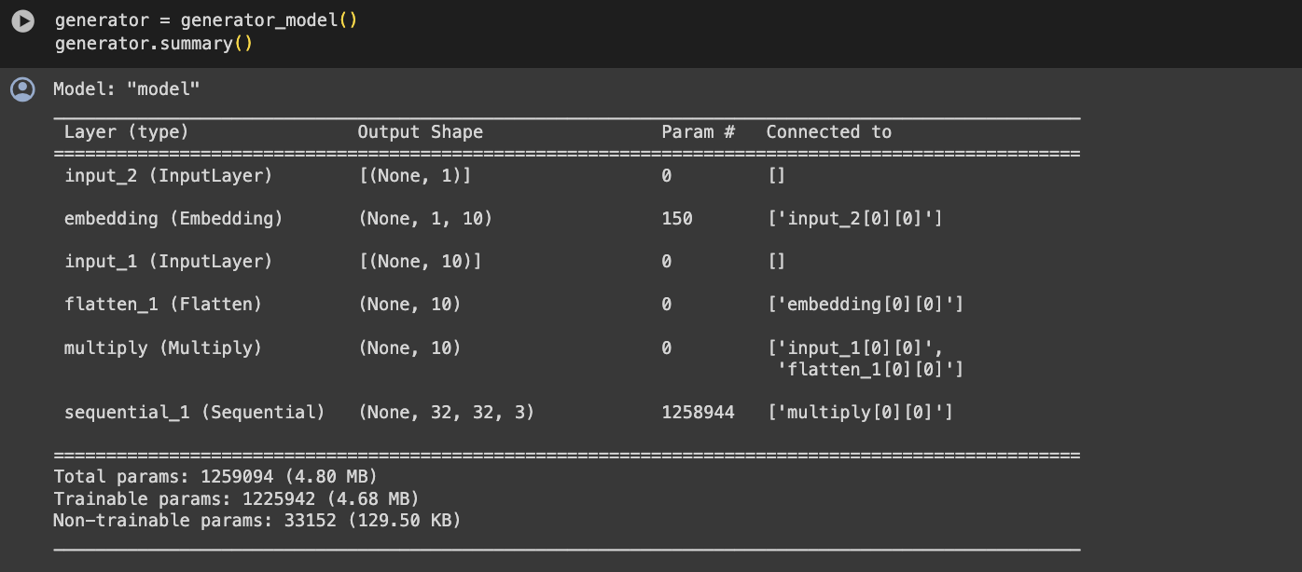
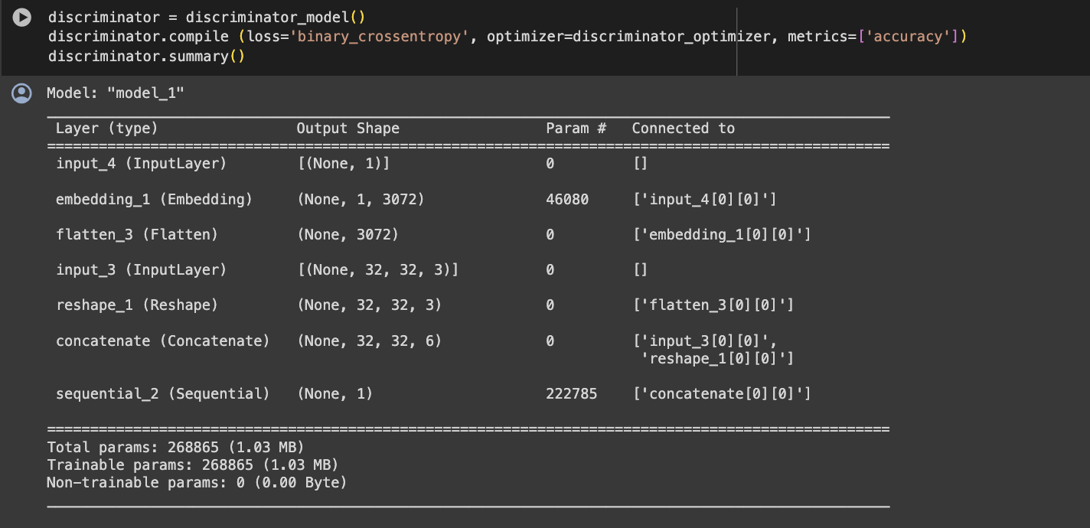

Slide 15
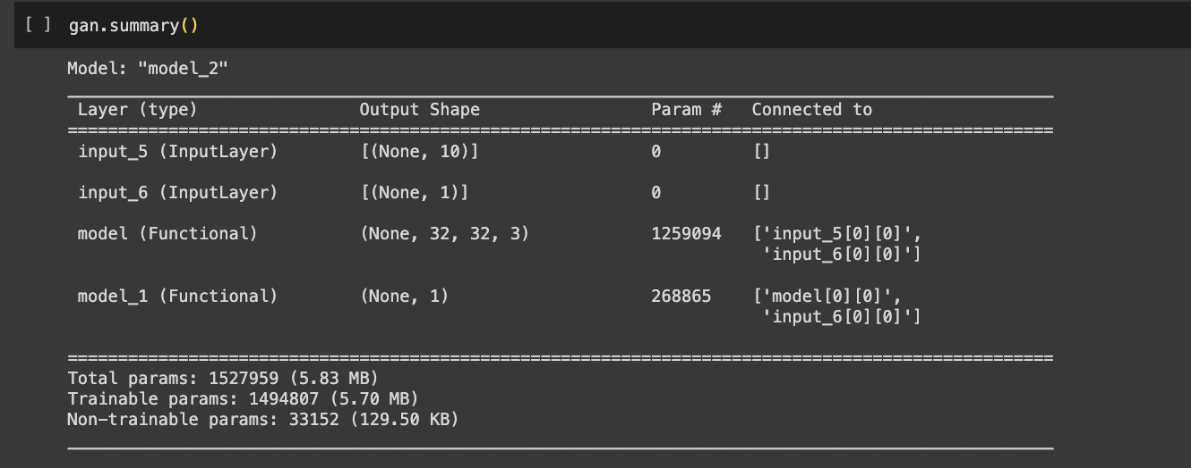
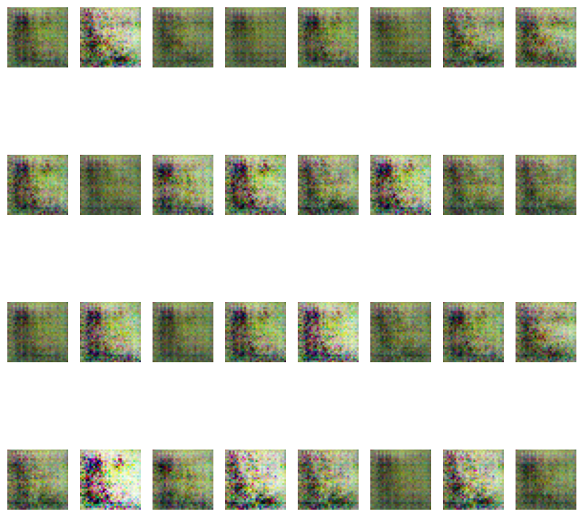

Slide 16
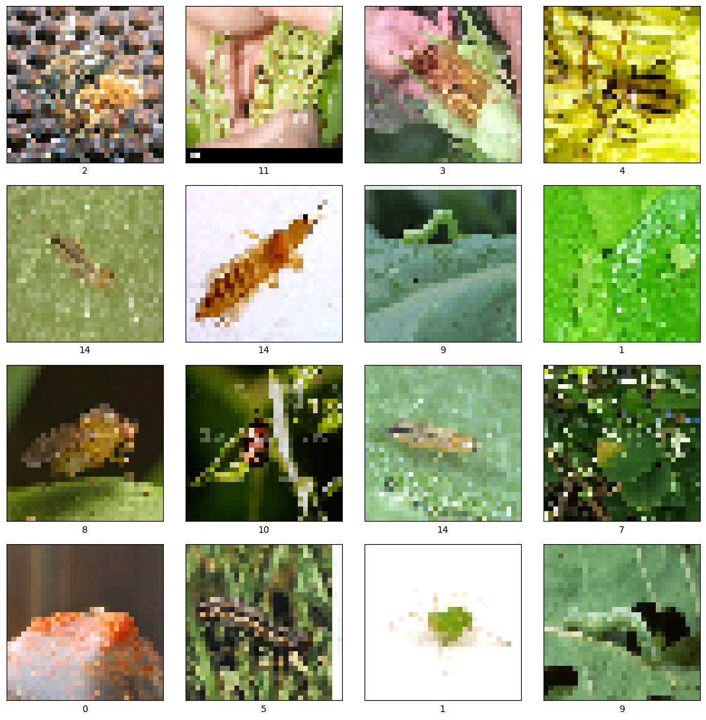
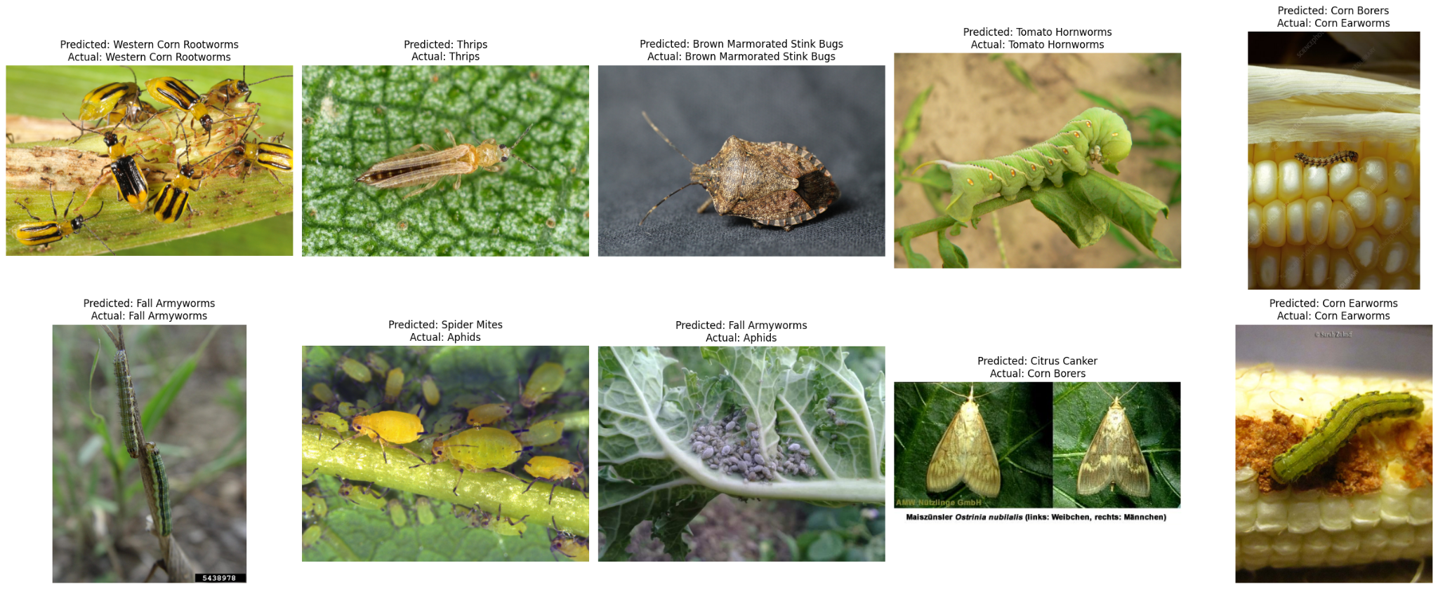

Slide 17
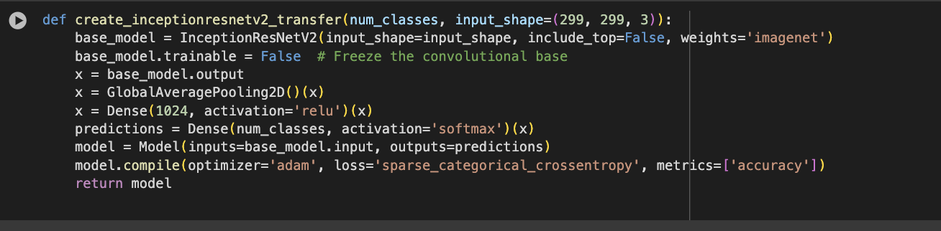
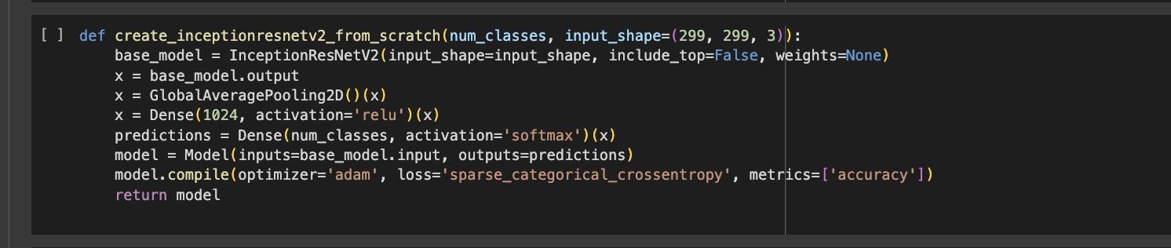
State of The Art models
Transfer Learning model
inceptionresnetv2_transfer
inceptionresnetv2_scratch

Slide 18
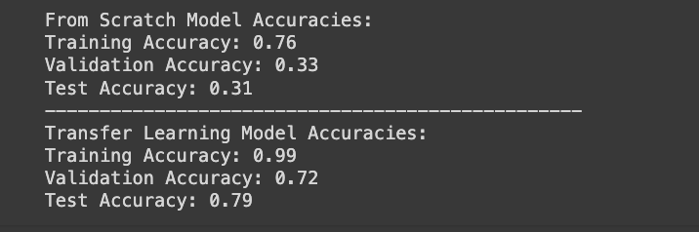
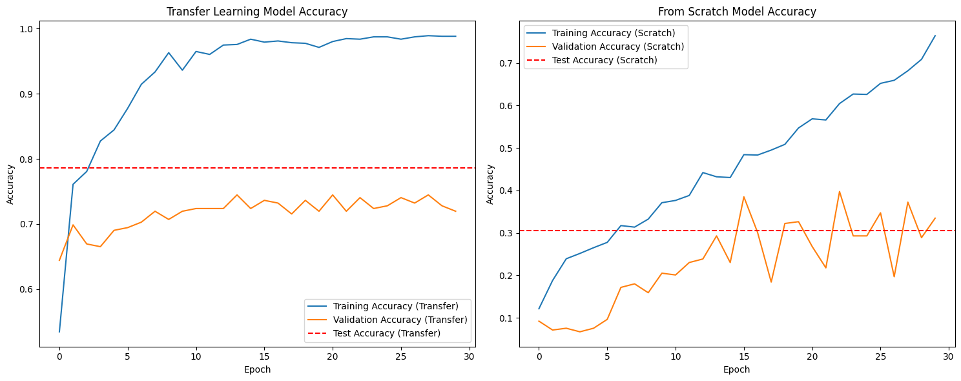

Slide 19
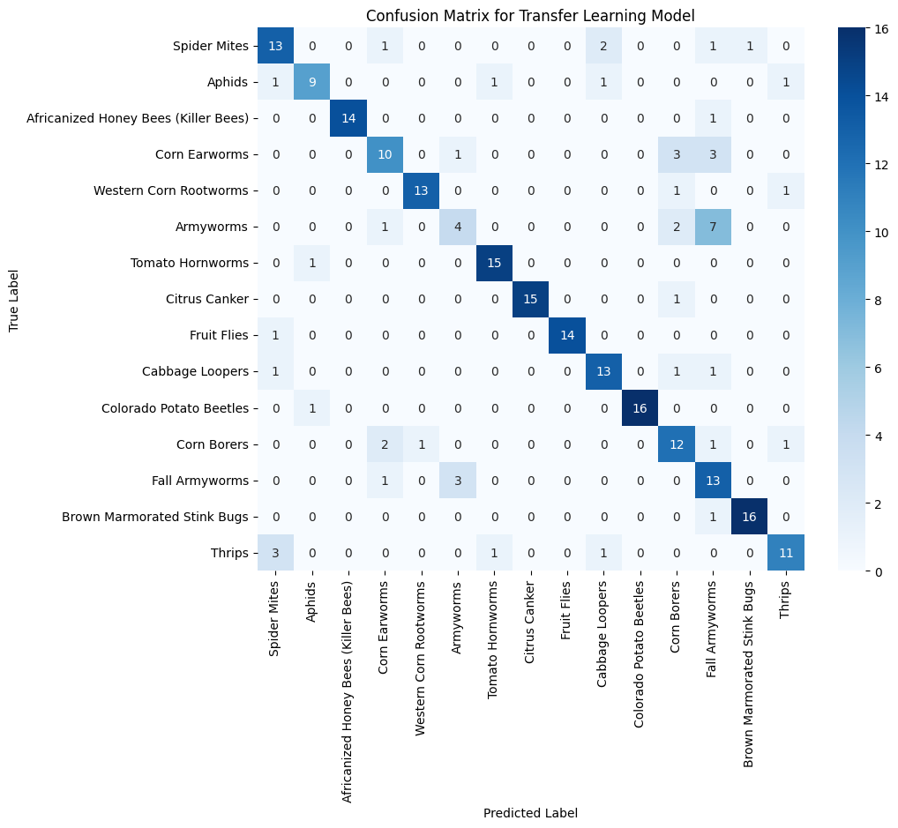
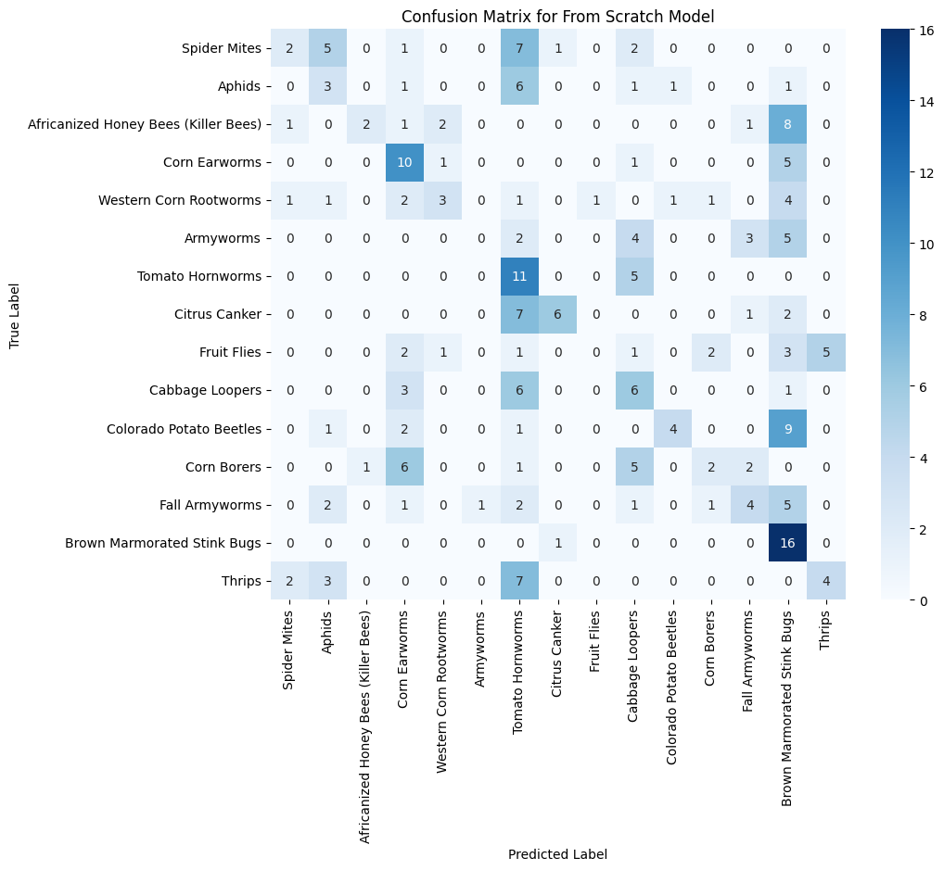

Slide 20
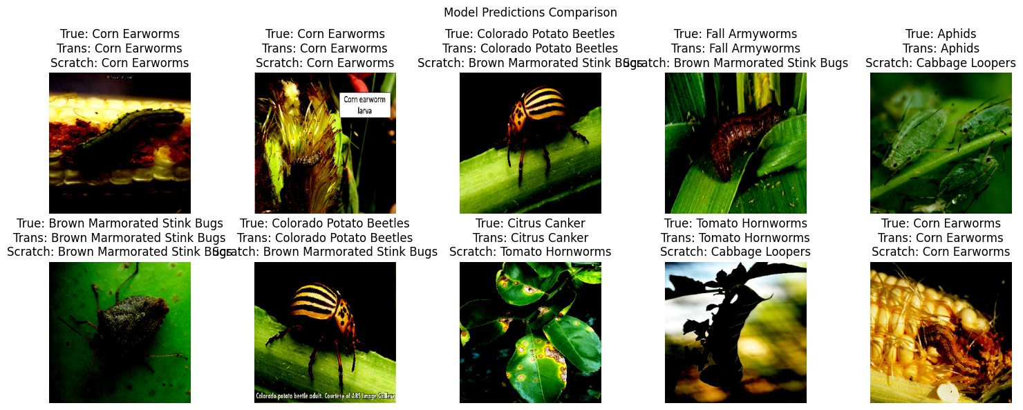

Slide 21
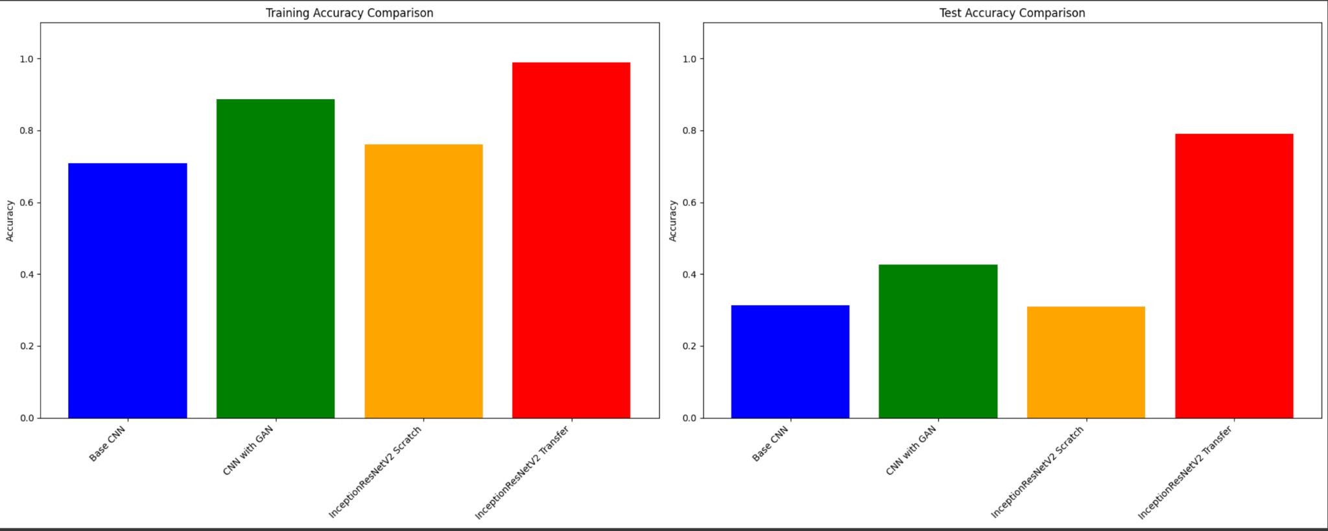
Model Comparison

Slide 22
Results
CNN experienced a low accuracy, however, after using GAN the accuracy could increase.The state-of-the-art model has shown a significant improvement in performance, particularly when using transfer learning.
InceptionResNetV2 with pre-trained weights excels in feature capture and generalization for accurate classification.
Data augmentation via GANs is useful, particularly with small datasets, but the quality of generated data is vital.
Balancing model complexity with dataset size is essential to avoid overfitting; proper regularization and hyperparameter tuning are key.
Transfer learning is highly effective for this dataset, benefiting from robust features learned from extensive data.

Slide 23
Technical challenges & Solutions
Data: Aimed to use dataset of 75000 images, however due to vast size of the dataset, the team encountered significant difficulties in loading and processing the data in a timely manner.Therefore, switch to less quantity of dataset.
Training time: Training was time-consuming. Therefore, team tried to simplify the model by reducing the number of layers or parameters, applying transfer learning techniques using pre-trained models, or modifying the model architecture to be more computationally efficient.
Accuracy: The model demonstrated suboptimal accuracy, which could be attributed to the insufficient quantity of images for certain classes. Team tried to experiment on architecture of models and double checked each step to ensure accuracy of implementation.

Slide 24
Thanks for your attention!

